Slide 1
CIS 598 Project
Project Update
Tyler Smith

Slide 2
Overview/Recap
2D game from an overhead perspective
Procedurally generated levels
Spooky, cartoony aesthetic

Slide 3
Completed Tasks
Basic Player class
Basic Enemy class
Tilemap rendering and collision
Procedural level generation

Slide 4
To Do
Create more rooms
Implement more enemy types
Implement a PowerUps
Win Screen, Pause Screen, Start Screen
Boss that pursues the player
Sound FX

Slide 5
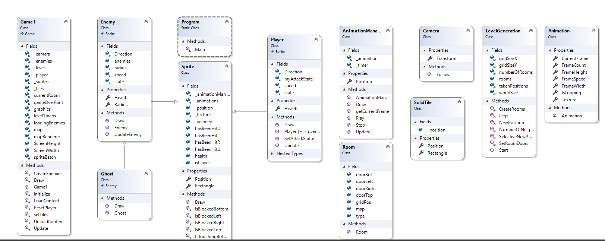

Slide 6
Demo

Slide 7
Questions?

